Slide 1

Deep Learning Project
Andi Muhammad Dirham D. || Annisa Sugesti || Atika Agustina

Slide 2

Pendahuluan
Dataset
Metode
Dataset Fashion MNIST dengan sepuluh kelas:
Label 0 : T_shirt/top
Label 1 : Trouser
Label 2 : Pullover
Label 3 : Dress
Label 4 : Coat
Label 5 : Sandal
Label 6 : Shirt
Label 7 : Sneaker
Label 8 : Bag
Label 9 : Ankle Boot
Dilakukan proses klasifikasi menggunakan metode Convolutional Neural Network (CNN)

Slide 3
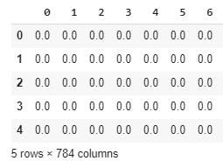
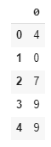
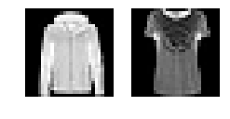
Pre-Processing
Akses Data Training
DataFrame
Label
Data Gambar
Jumlah Data Training : 55000 data

Slide 4
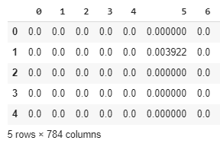
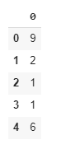
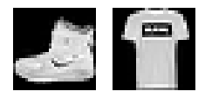
Pre-Processing
Akses Data Validasi
DataFrame
Label
Data Gambar
Jumlah Data Validasi : 5000 data

Slide 5
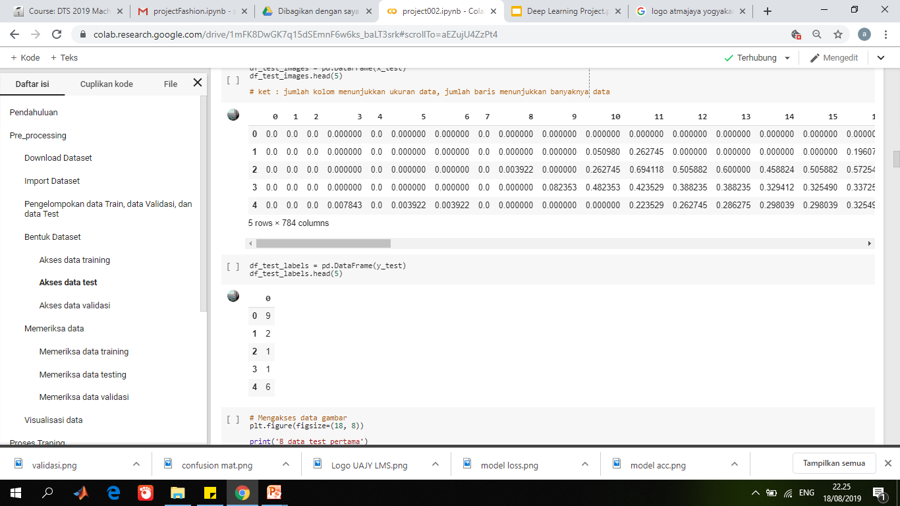
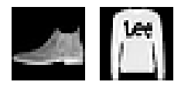
Pre-Processing
Akses Data Testing
DataFrame
Label
Data Gambar
Jumlah Data Testing : 10000 data

Slide 6
Pre-Processing
Pemeriksaan Data
Total nilai NaN di DataFrame training = 0
Total nilai NaN di DataFrame label training = 0
Total nilai NaN di DataFrame testing = 0
Total nilai NaN di DataFrame label testing = 0
Total nilai NaN di DataFrame validasi = 0
Total nilai NaN di DataFrame label validasi = 0

Slide 7
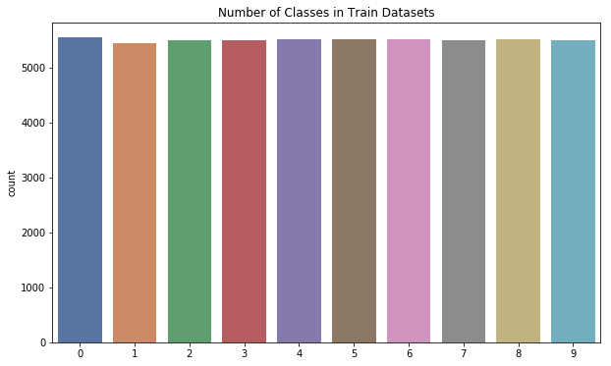
Pre-Processing
Visualisasi Data

Slide 8
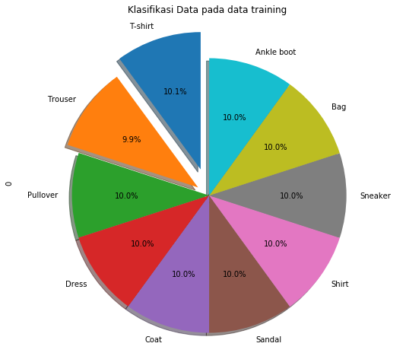
Pre-Processing
Visualisasi Data

Slide 9
Proses Training
Pembentukan Model CNN
Code dalam Pembentukan Model
# Pembentukan Model
model = Sequential()
# Convolusi layer 1
model.add(Conv2D(64, kernel_size=(3, 3), activation='linear', kernel_initializer='he_normal', input_shape=input_shape))
model.add(LeakyReLU(alpha=0.1))
model.add(MaxPooling2D((2, 2))) #reduksi dimensi
model.add(Dropout(0.25)) # Add dropouts to the model
# Convolusi layer 2
model.add(Conv2D(64, kernel_size=(3, 3), activation='linear'))
model.add(LeakyReLU(alpha=0.1))
model.add(MaxPooling2D(pool_size=(2, 2))) #reduksi dimensi
model.add(Dropout(0.25)) # Add dropouts to the model

Slide 10
Proses Training
Pembentukan Model CNN
# Convolusi layer 3
model.add(Conv2D(128, (3, 3), activation='linear'))
model.add(LeakyReLU(alpha=0.1))
model.add(Dropout(0.4)) # Add dropouts to the model
#FULLY CONNECTED LAYER
model.add(Flatten()) #konversi menjadi data satu dimensi
model.add(Dense(128, activation='linear'))
model.add(LeakyReLU(alpha=0.1))
model.add(Dropout(0.3)) # Add dropouts to the model
#OUTPUT LAYER
model.add(Dense(10, activation='softmax'))

Slide 11
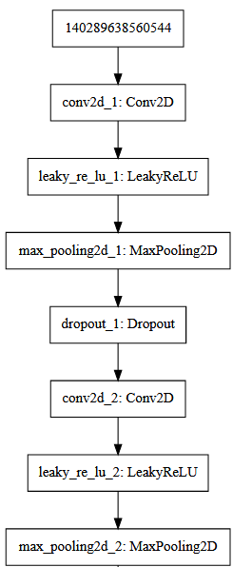
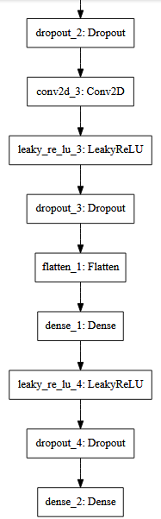
Proses Training
Model CNN

Slide 12
Proses Training
Fitting Model
Code dalam Fitting Model
# Adam Optimizer
adam = Adam(lr=0.001) # lr = learning rate
# compiling and fitting model
model.compile(optimizer=adam, loss='sparse_categorical_crossentropy', metrics=['accuracy'])
history = model.fit(x_train, y_train, validation_data=(x_val, y_val), epochs=60, verbose=1, batch_size=128)

Slide 13
Proses Training
Fitting Model
Hasil dari dua epoch terakhir:
Epoch 59/60
Loss = 0.2327 – acc = 0.9105
Val_loss = 0.2268 -- val_acc = 0.9146
Epoch 60/60
Loss = 0.2322 – acc = 0.9113
Val_loss = 0.2170 -- val_acc = 0.9208

Slide 14
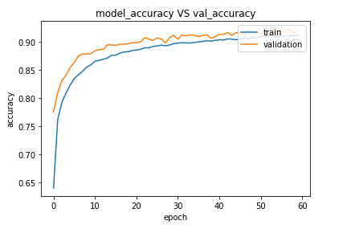
Proses Training
Akurasi Model

Slide 15
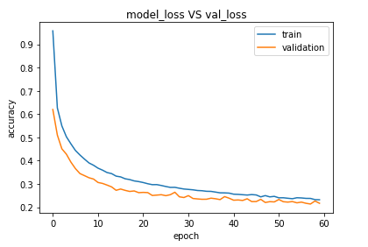
Proses Training
Akurasi Model

Slide 16
Evaluasi Model
Pengujian (Testing) Model
Hasil Evaluasi Model pada Test Set :
Test loss = 0.2479706649541855
Test accuracy = 0.9113
Total correct prediction = 9113
Total incorrect prediction = 887

Slide 17
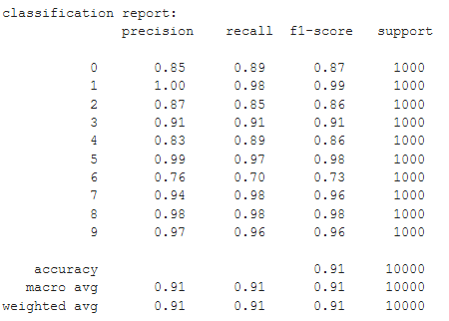
Evaluasi Model
Classification Report

Slide 18
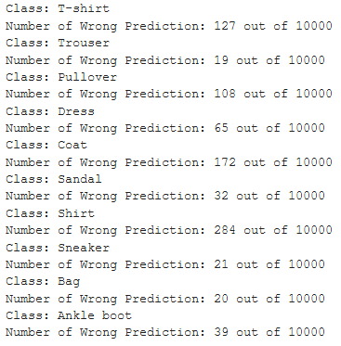
Evaluasi Model
Classification Report

Slide 19
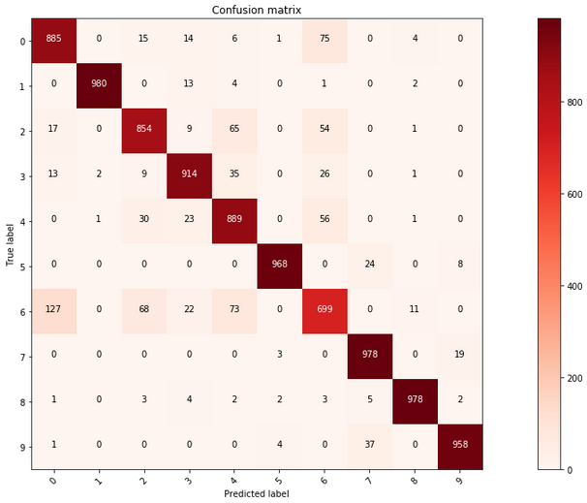
Evaluasi Model
Confusion Matrix

Slide 20







THANKYOU !
digitalent.kominfo
digitalent.kominfo
DTS_kominfo
Digital Talent Scholarship 2019
digitalent.kominfo.go.id

